Slide 1
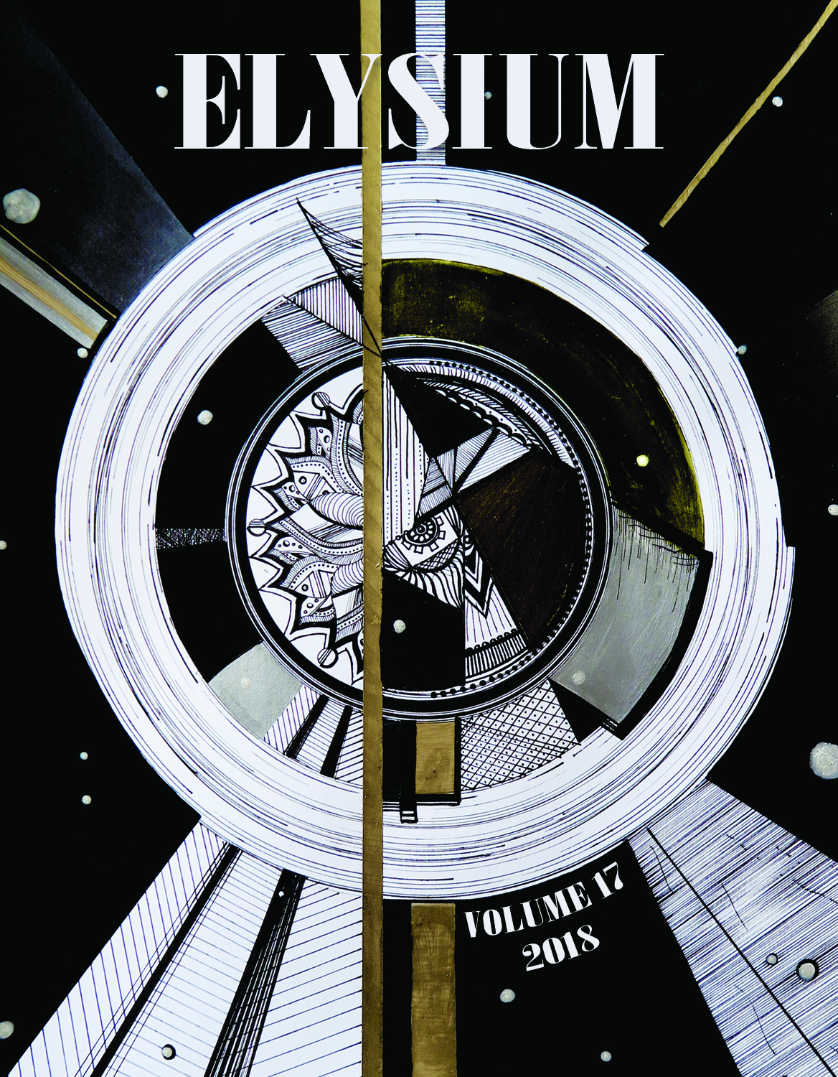
The 2018 edition of
Elysium’s Literary/Art Magazine

Slide 2

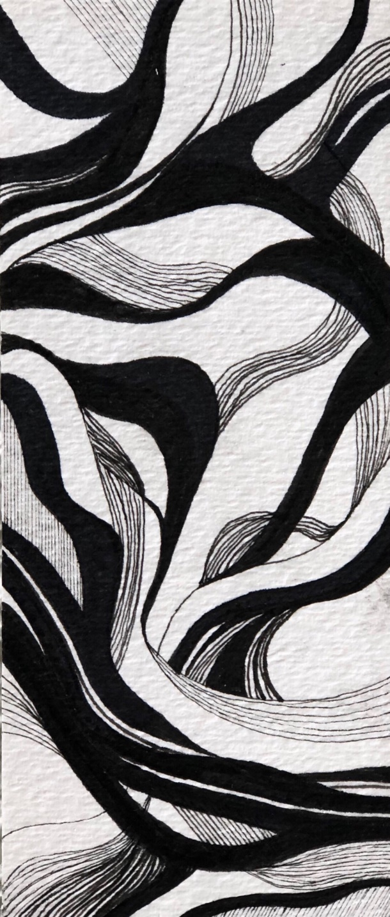
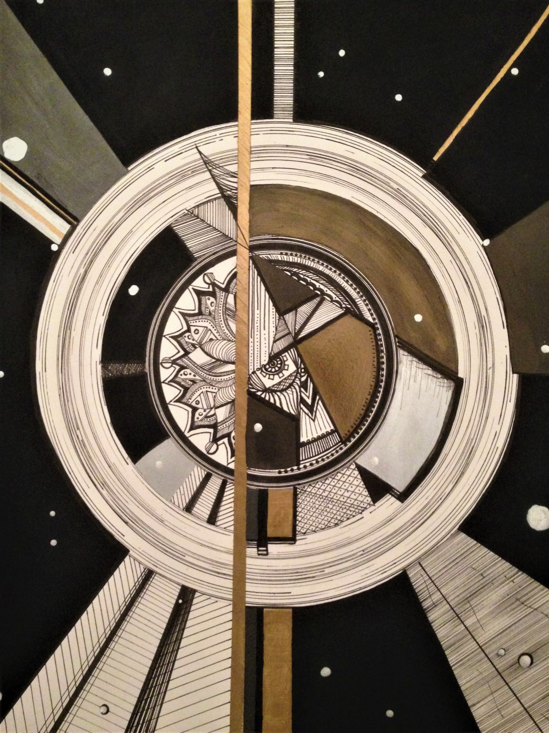
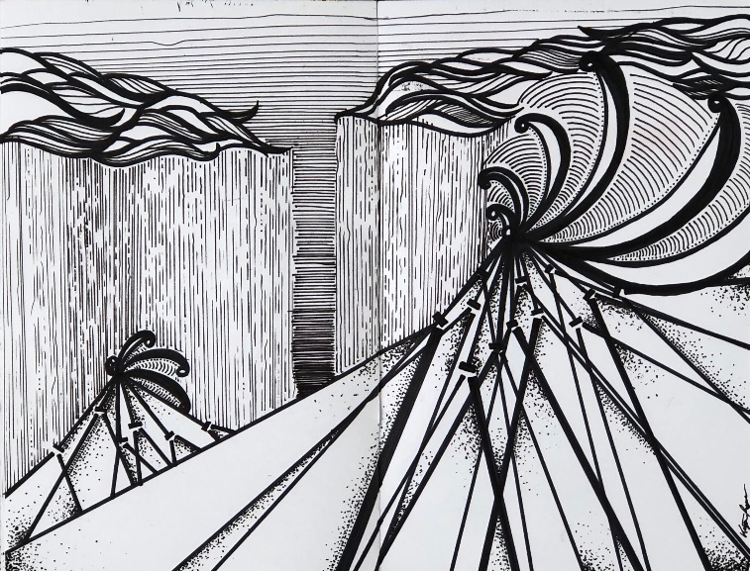
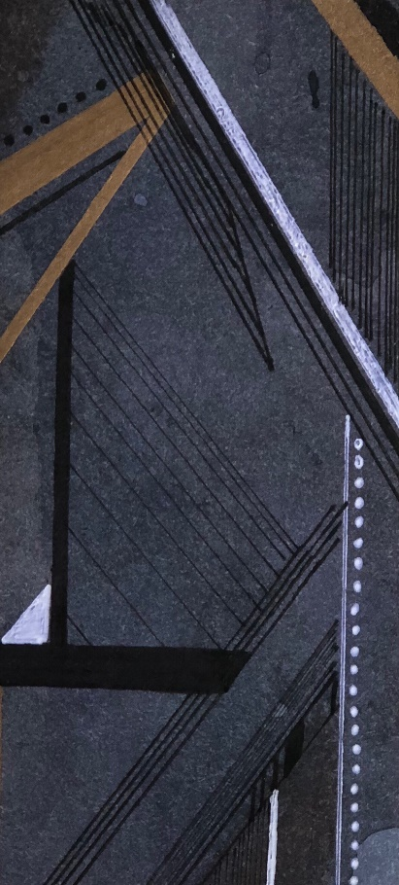

Cover and
Graphics by
Kaitlyn Rezek

Slide 3

Anik Willig - Violinist
playing
Mozart’s
Concerto in G
no. 3

Slide 4

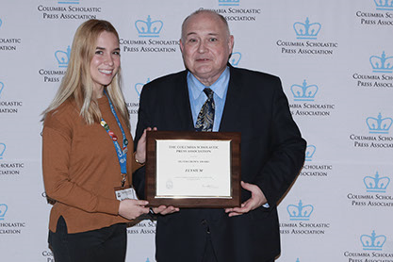

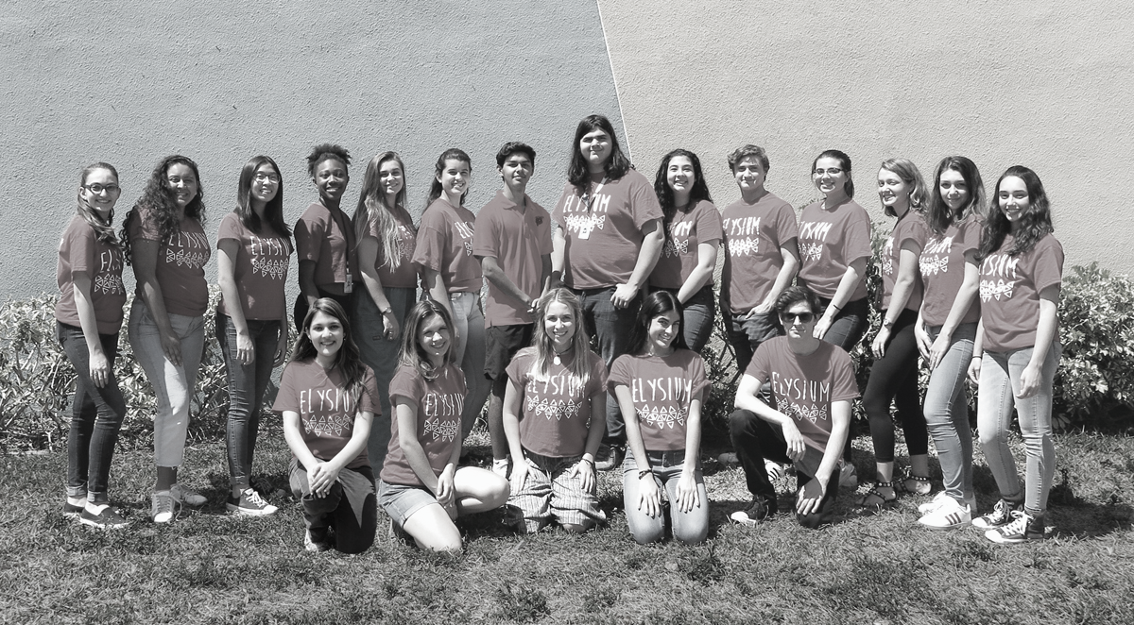
2018 Staff of Elysium
2018 Editor in chief
Sophia Lord

Slide 5

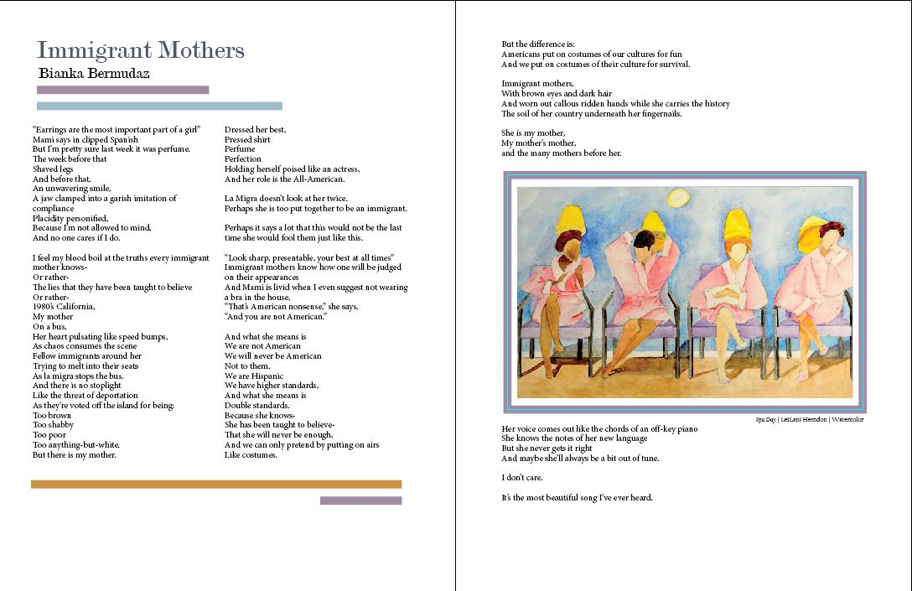

Slide 6

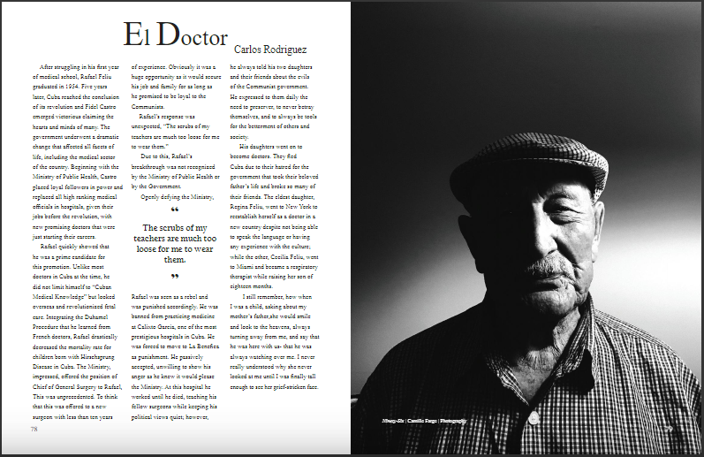

Slide 7
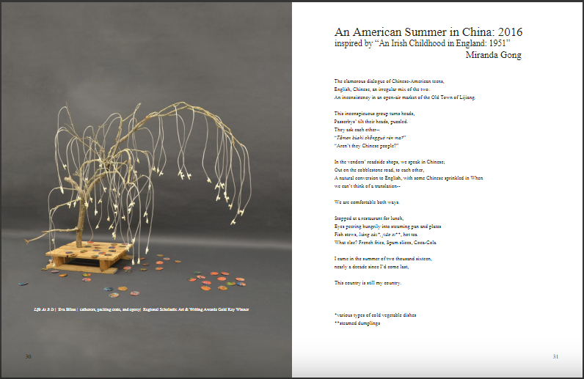
M
I
R
A
N
D
A
G
O
N
G

Slide 8
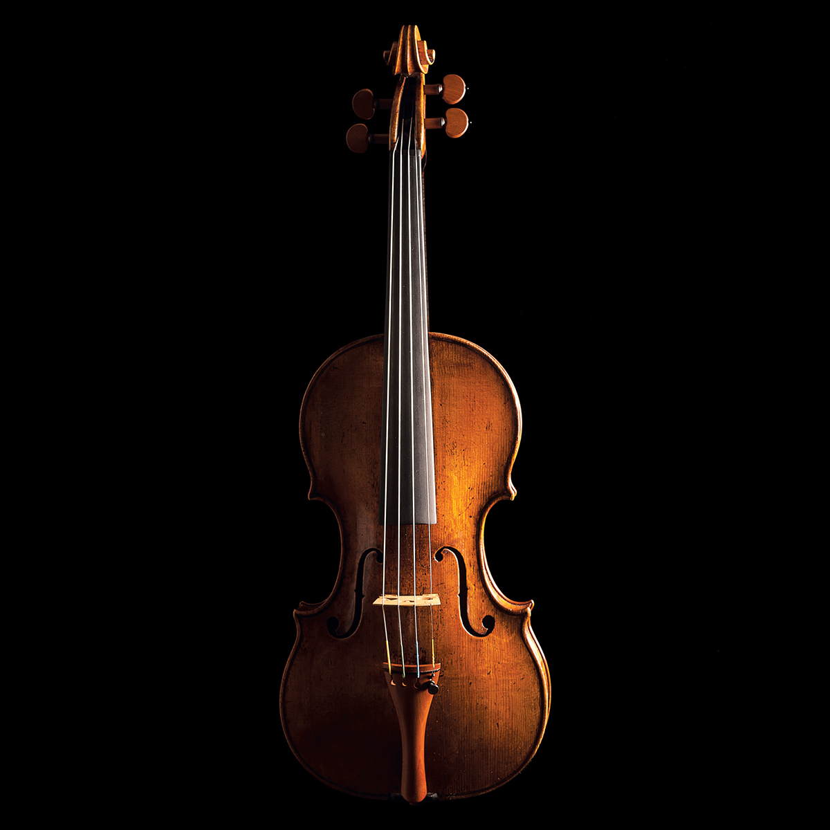
Abigail Martinez Cellist
Performs
Romanian Folk Dances
By Bela Bartok

Slide 9

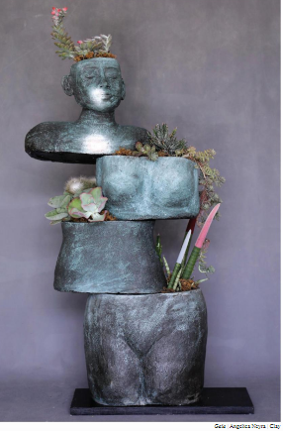
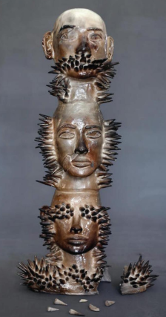
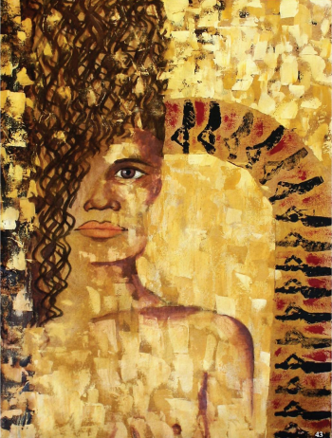

Slide 10
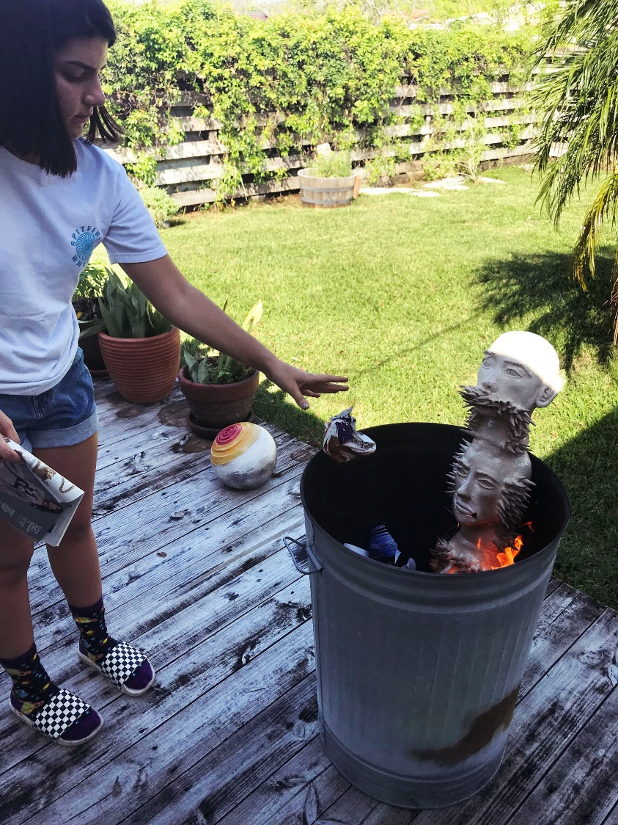
The Process

Slide 11

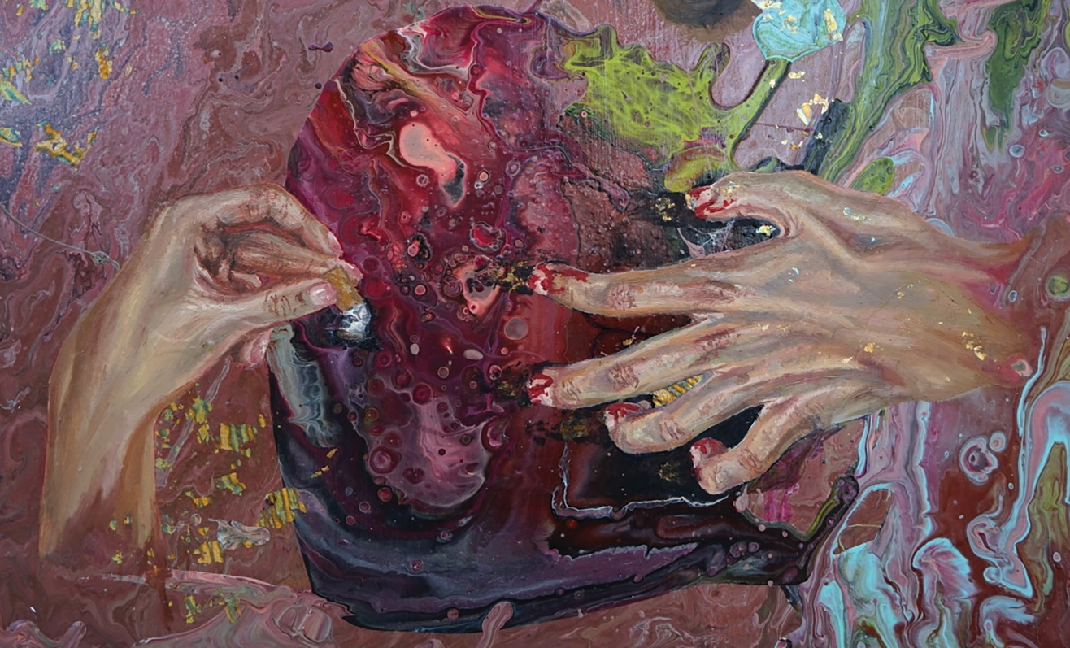
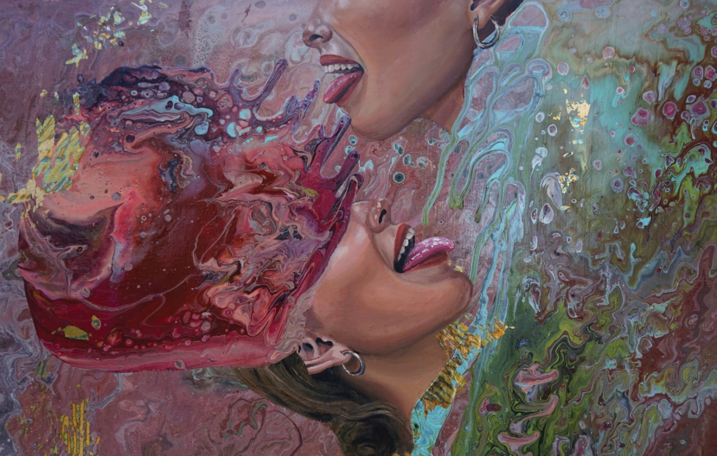
Catalina Cortes

Slide 12
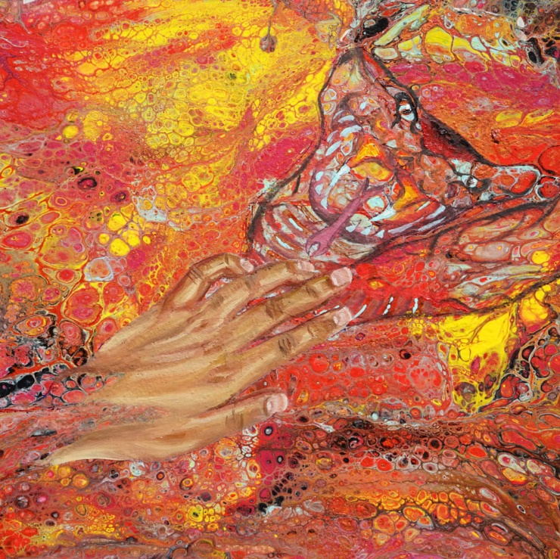

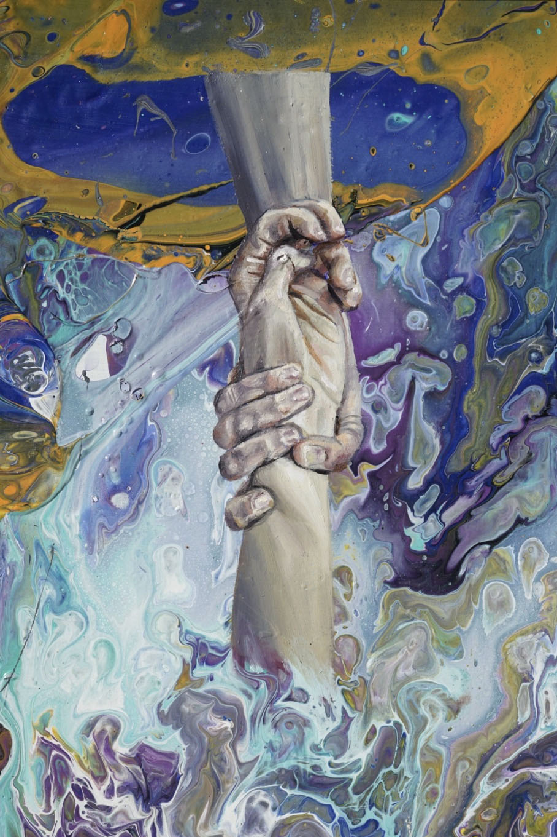

Catalina
Cortes

Slide 13
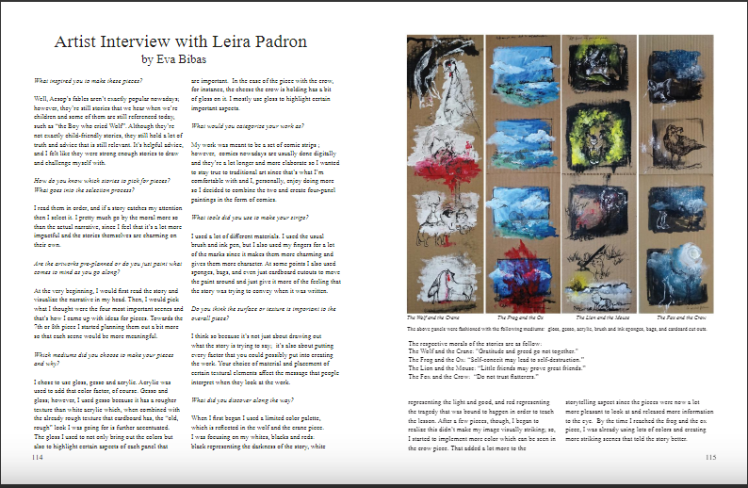
Leira Padron

Slide 14
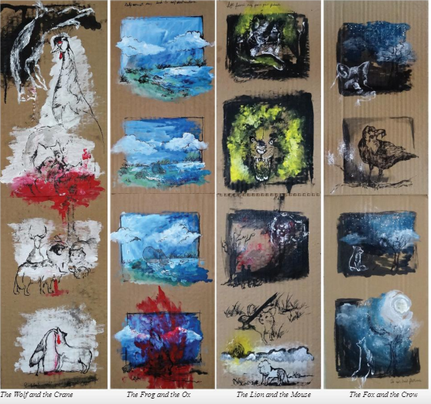

Slide 15
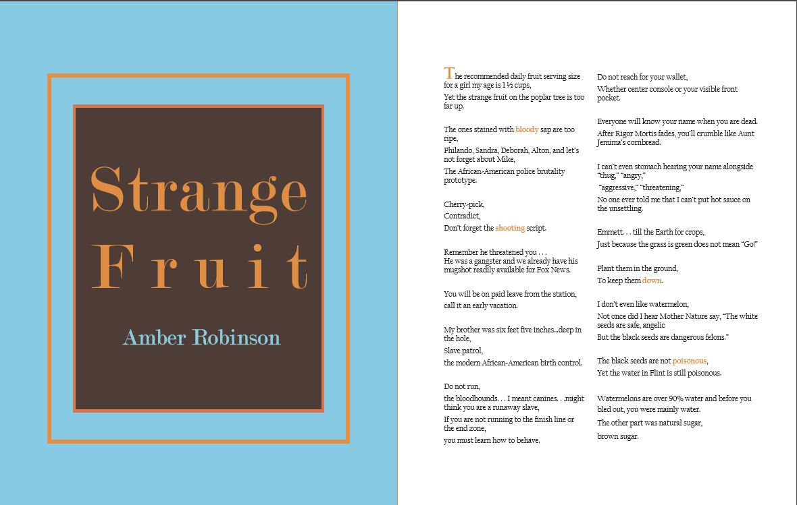
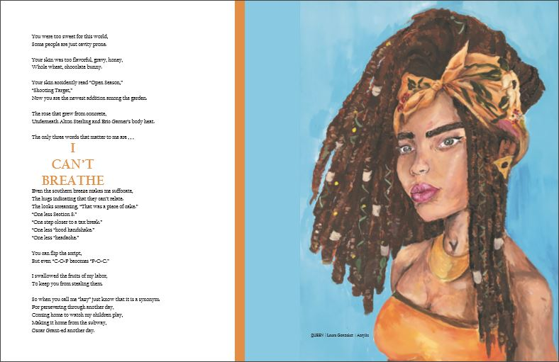
Amber Robinson

Slide 16
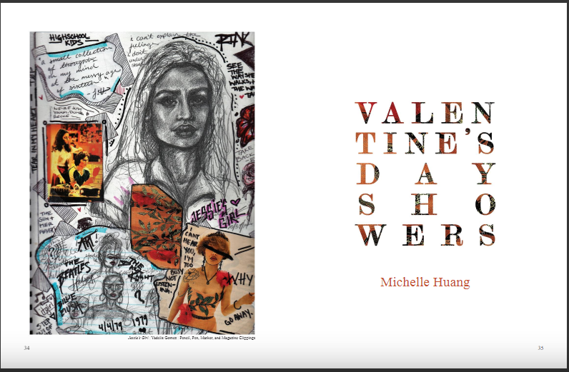
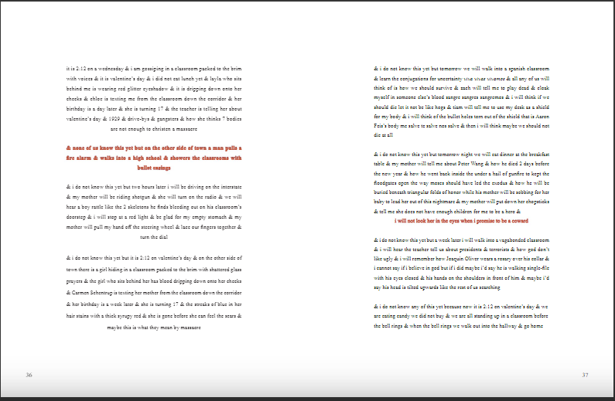
Michelle Huang

Slide 17
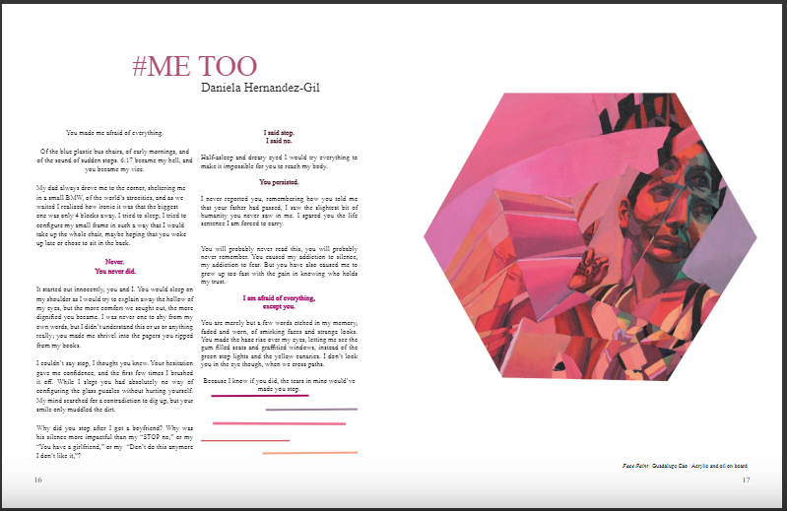
D
A
N
I
E
L
A
H
E
R
N
A
N
D
E
Z

Slide 18
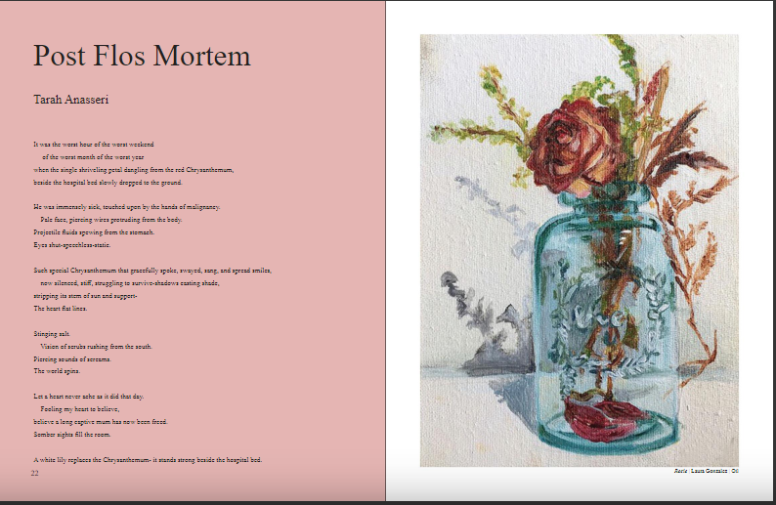
Tarah Anassari

Slide 19
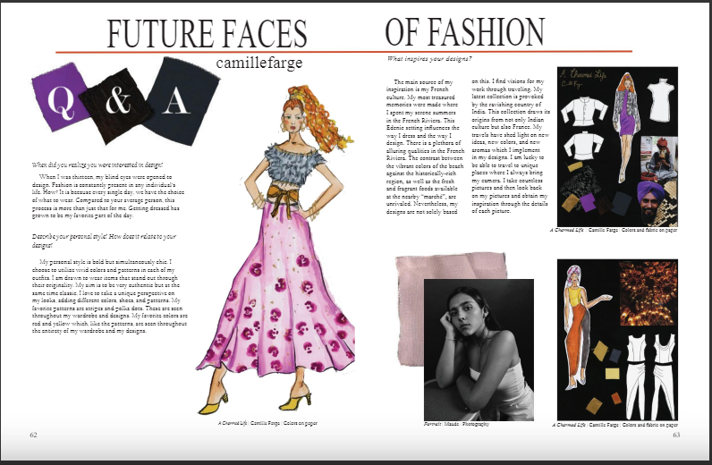
CAMILLE FARGE FASHION

Slide 20

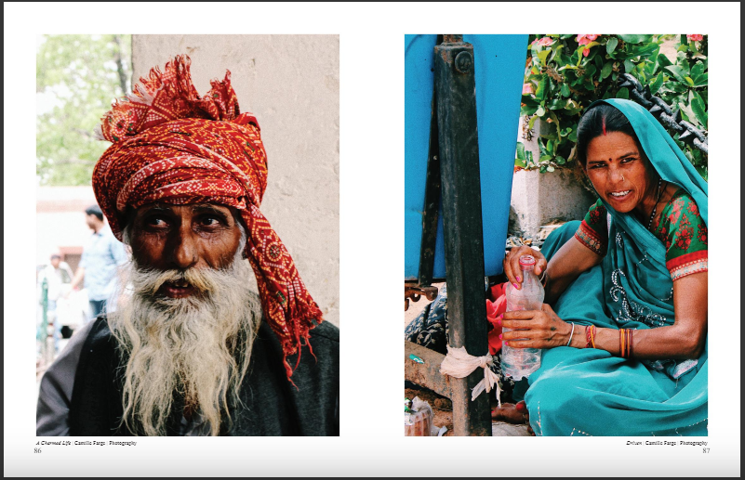
CAMILLE FARGE PHOTOGRAPHY

Slide 21
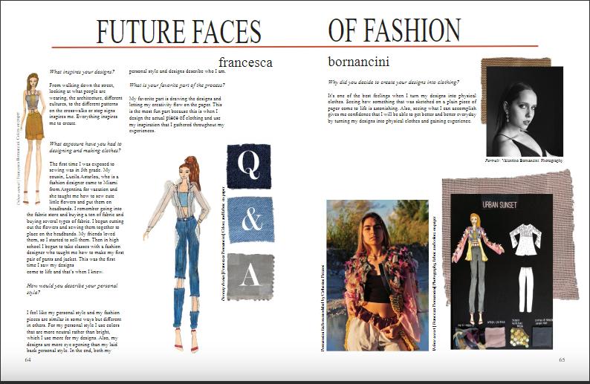
Francesca Bornancini Fashion

Slide 22

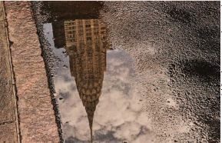
Francesca Bornancini
Photography

Slide 23
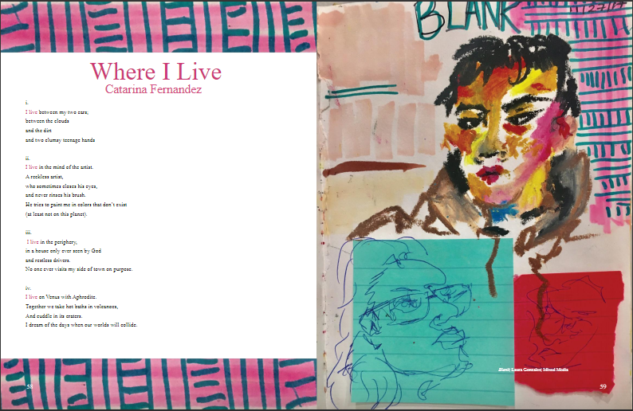
Catarina Fernandez

Slide 24
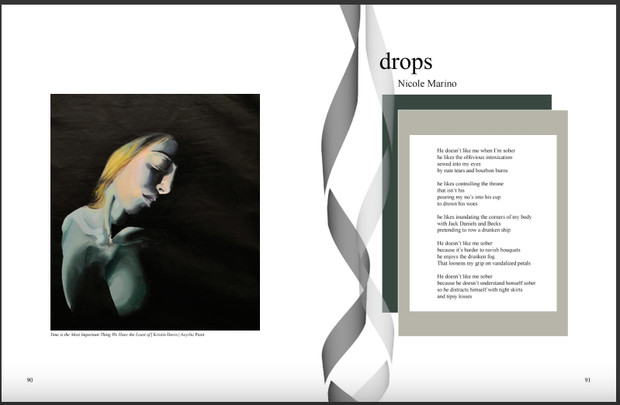
Nicole Marino

Slide 25
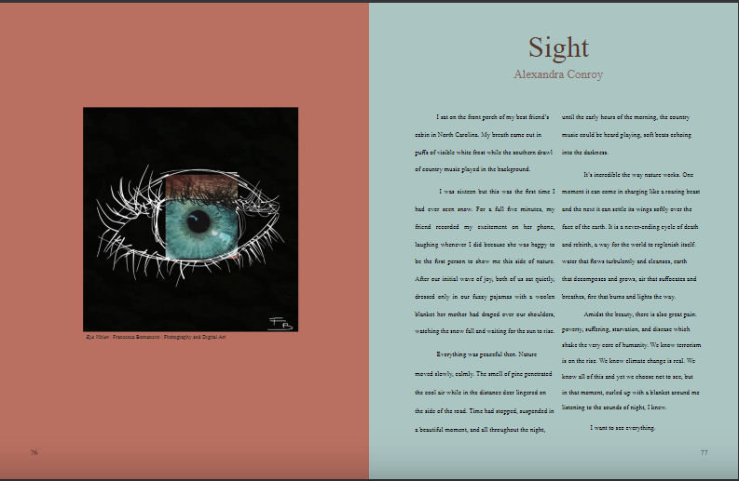
Alexandra Conroy

Slide 26
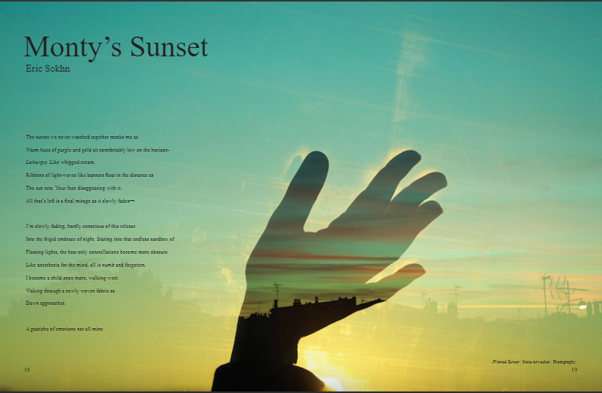
E
R
I
C
S
0
k
h
n

Slide 27

Taimera Johnson
Sings
“You Love Me” by Jill Scott

Slide 28


